Slide 1

Messaging Channels
System Integration
PBA Softwareudvikling/BSc Software Development
Tine Marbjerg
Fall 2017
Messaging Channels

Slide 2
Overall considerations about messaging channels
Messaging Channels

Slide 3
Message Channel Characteristics
Fixed set of channels
  Number of channels tends to be static - agreed upon at design time
  Possible exception: reply channel in Request-Reply
Unidirectional channels
  Channels are like buckets that applications add and take data from, but messages gives direction
  For practical reasons, two-way communication needs two channels (i.e. makes channels unidirectional)
Messaging Channels

Slide 4
Message Channel Decisions (1)
One-to-one or one-to-many channel?
  Message will be received by only one application (Point-to-Point)
  Message copied for each of the receivers (Publish-Subscribe)
What type of data on channel
  All data on a channel should be of the same type, i.e. structure, format etc. (Datatype Channel)
  Main reason that messaging systems needs lots of channels
Messaging Channels

Slide 5
Message Channel Decisions (2)
Error handling: What happens to invalid and undeliverable messages?
  If delivered properly, there is no guarantee the receiver knows what to do with an invalid message
    Receiver puts the ‘strange’ message on Invalid Message Channel
  Delivery problem
    Messaging system puts message on Dead Letter Channel
Must messaging system be crash proof?
  By default, channels store messages in memory
  Guaranteed Delivery makes channels persistent so messages are store on disk
Messaging Channels

Slide 6
Message Channel Decisions (3)
What to do with clients not built for messaging?
  Channel Adapter makes applications that cannot connect to a messaging system able to connect to a channel without modifying application
Channels as communication backbone
  Messaging system can become a centralized point for shared functionality in the enterprise
  Message Bus: a backbone of channels that gives unified access to an enterprise’s applications and makes them share functionality
    Common data model
    Command set of commands
Messaging Channels
Notes:
Router og translator are process steps in pipes and filters
p. 102: Mom connects to non-messaging client via user interface, database, business service API etc.

Slide 7
Design of messaging channels:
Use of Patterns
Messaging Channels

Slide 8

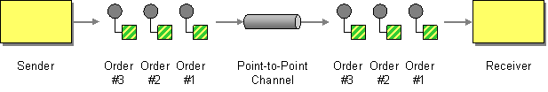
Point-to-Point Channel (103)
How can the caller be sure that exactly one receiver will receive the document or perform the call?
Send the message on a Point-to-Point Channel, which ensures that only one receiver will receive a particular message.
OBS!
If the channel has multiple receivers, only one of them can successfully consume a particular message.
The channel ensures that only one of them succeeds, i.e. the receivers do not have to coordinate with each other.
Messaging Channels
Notes:
The channel can still have multiple receivers to consume multiple messages concurrently, but only a single receiver consumes any one message (Competing Consumers (502) –load-balancing)

Slide 9

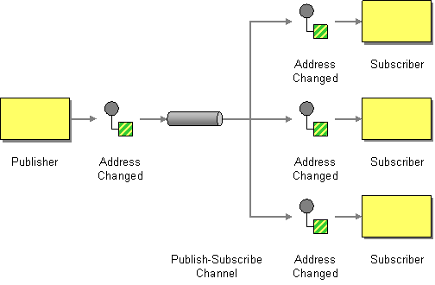
Publish-Subscribe Channel (106)
How can the sender broadcast an event to all interested receivers?
Send the event on a Publish-Subscribe Channel, which delivers a copy of a particular event to each receiver.
  One input channel splits into multiple output channels
  Each output channel has only one subscriber
  MSMQ doesn’t support natively (Multicasting support must be used)
Messaging Channels
Notes:
Msmq – multicasting – rabbitmq - NServiceBus

Slide 10

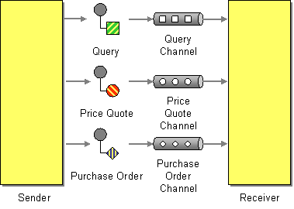
Datatype Channel (111)
How can the application send a data item such that the receiver will know how to process it?
Use a separate Datatype Channel for each data type, so that all data on a particular channel is of the same type.
Messaging Channels

Slide 11

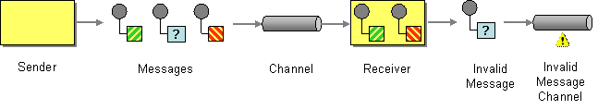
Invalid Message Channel (115)
How can a messaging receiver gracefully handle a message that makes no sense?
The receiver should move the improper message to an Invalid Message Channel, a special channel for messages that could not be processed by their receivers.
Messaging Channels

Slide 12
Invalid Message Example
//Receiver
...
try {
// read message
}
catch ( Exception )
{
//Invalid message detected
invalidQueue.Send(requestMessage);
}
Messaging Channels

Slide 13

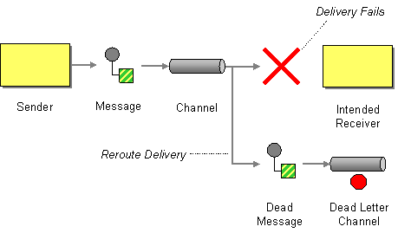
Dead Letter Channel (119)
What will the messaging system do with a message it cannot deliver?
When a messaging system determines that it cannot deliver a message, it can move the message to a Dead Letter Channel.
Messaging Channels
Notes:
The specific way a Dead Letter Channel works depends on the specific messaging system’s implementation, if it provides one at all.

Slide 14

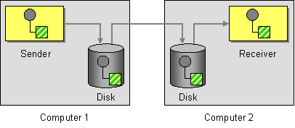
Guaranteed Delivery (122)
How can the sender make sure that a message will be delivered, even if the messaging system fails?
Use Guaranteed Delivery to make messages persistent so that they are not lost even if the messaging system crashes.
  The msg. system uses a built-in data store to persist messages.
  Each computer that the messaging system is installed on has its own data store so that the messages can be stored locally until successfully forwarded to and stored in the next data store
  Hurts performance, but more reliable
Messaging Channels
Notes:
the message is not deleted from one data store until it is successfully forwarded to and stored in the next data store (store-and-forward)

Slide 15

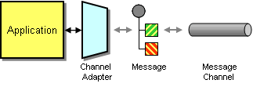
Channel Adapter (127)
How can you connect an application to the messaging system so that it can send and receive messages?
Use a Channel Adapter that can access the application's API or data to publish messages on a channel based on this data, and that likewise can receive messages and invoke functionality inside the application.
Messaging Channels

Slide 16
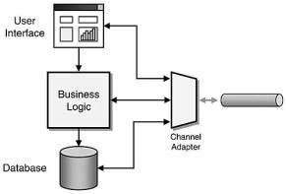
Adapter - Connect to different layers
Depending on application architecture, the Channel Adapter can connect to different layers in application:
Messaging Channels
Notes:
Message-oriented middleware
Ui adapter – brittleness and slow speed

Slide 17
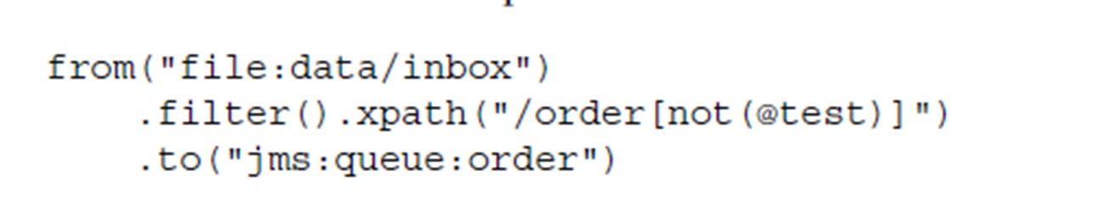
Examples of Data Extraction
Camel - A routing engine with domain specific languages
  Java example 1
  Define route that consumes files from a file endpoint to JMS channel:
  from("file:data/inbox").to("jms:queue:order");
  Java example 2
  Messages are routed to a filter, which uses XPath to check whether the message is a test order or not. If message passes the check, it routes to JMS endpoint.
Messaging Channels

Slide 18
Connect to different layers – pros & cons
User Interface Adapter
  HTML based UI → make HTTP request and parse result
  Screen scraping (e.g. from 3270 terminal)
Business Logic Adapter
  Access core functions exposed as API
Database Adapter
  Data can be extracted from database without application noticing
  Adapter can add trigger to relevant tables and send messages when changes happen
  Non intrusive to application, but deep into internals of data structure (brittle if database design changes)
Messaging Channels
Notes:
Message-oriented middleware

Slide 19

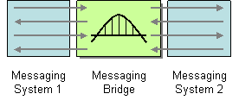
Messaging Bridge (133)
How can multiple messaging systems be connected so that messages available on one system are also available on the others?
Use a Messaging Bridge, a connection between messaging systems, to replicate messages between systems.
The bridge acts as map from one set of channels to the other, and transforms the message format of one system to the other
Messaging Channels
Notes:
Typically, there is no practical way to connect two complete messaging systems, so instead we connect individual, corresponding channels between the messaging systems
The Messaging Bridge is a set of Channel Adapters, where the non-messaging client is a actually another messaging system, and where each pair of adapters connects a pair of corresponding channels

Slide 20

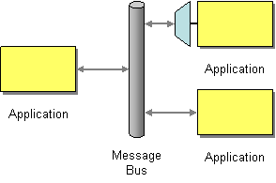
Message Bus (137)
Architecture that enables separate applications to work together, but in a decoupled fashion such that applications can be easily added or removed without affecting the others.
Message Bus enables applications to work together using messaging.
    Common data model
    Command set of commands
Messaging Channels

Slide 21
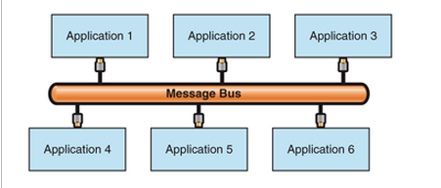

Applications communicating through bus
Application that sends messages must prepare the messages so that they comply with the type of messages the bus expects.
Application that receives messages must be able to understand (syntactically) the message types.
If all applications in the integration solution implement the bus interface, adding applications or removing applications from the bus incurs no changes.
Messaging Channels
Notes:
HOW does receiving applications get the messages from the bus?
Publish-subscribe or
Routing

